Slide 1
Introduction to Data Analysis

Slide 2
STATISTICAL LEARNING
Patrick Boily Data Action Lab | uOttawa | Idlewyld Analytics
[with files from Jen Schellinck | Sysabee]

Slide 3

TYPES OF LEARNING
The central Data Science/Machine Learning problem is:
can (should) we design algorithms that can learn?
Supervised Learning (learning with a teacher)
classification, regression, rankings, recommendations
uses labeled training data (student gives an answer to each test question based on what they learned from worked-out examples)
performance is evaluated using testing data (teacher provides the correct answers)
a target exists against which to train the model

Slide 4
TYPES OF LEARNING
Unsupervised Learning (grouping similar exercises together as a study aid)
clustering, association rules discovery, link profiling, anomaly detection
uses unlabeled observations (teacher is not involved)
accuracy cannot be evaluated (students might not end up with the same groupings)
the concept of a target is not applicable
Others:
semi-supervised learning (teacher providing worked-out examples and a list of unsolved problems)
reinforcement learning (embarking on a Ph.D. with an advisor?)

Slide 5
ASSOCIATION RULES BASICS
Association Rule Discovery is a type of unsupervised learning that finds connections among attributes (and combinations of attributes).
Examples:
bread and milk are often purchased together… is that interesting?
hot dogs and mustard are also often purchased as a pair, but more rarely purchased individually… is that interesting?
A supermarket could then have a sale on hot dogs to drive in customers, while raising the price on condiments, to maintain profit margins.

Slide 6
CAUSATION AND CORRELATION
[E. Siegel, Predictive Analytics: The Power to Predict Who Will Click, Buy, Lie, or Die]
Insight | Organization
Pop-Tarts before a hurricane | Walmart
Higher crime, more Uber rides | Uber
Typing with proper capitalization indicates creditworthiness | A financial services startup company
Users of the Chrome and Firefox browsers make better employees | A human resources professional services firm, over employee data from Xerox and other firms
Men who skip breakfast get more coronary heart disease | Harvard University medical researchers
More engaged employees have fewer accidents | Shell
Smart people like curly fries | Researchers at the University of Cambridge and Microsoft Research
Female-named hurricanes are more deadly | University researchers
Higher status, less polite | Researchers examining Wikipedia behavior

Slide 7
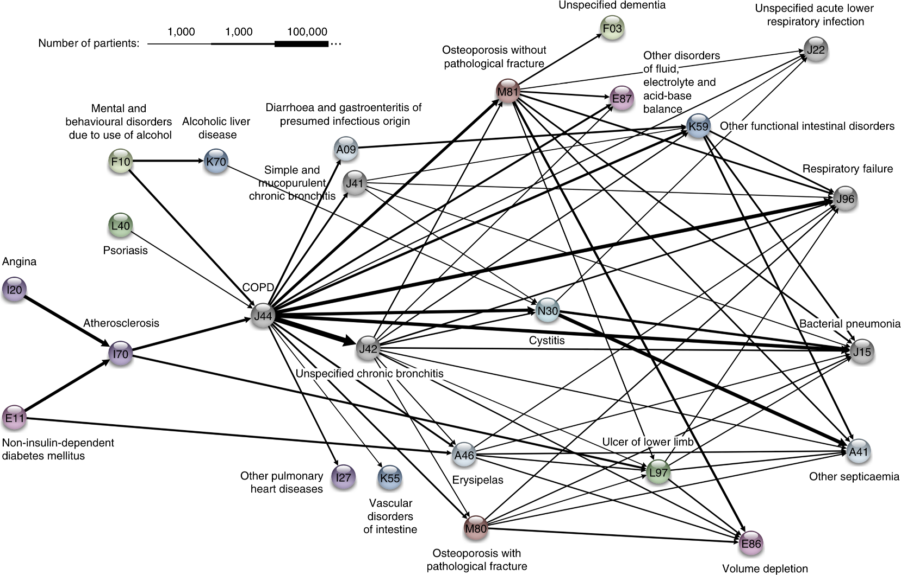
1,000 10,000 100,000
Jensen, A.B., Moseley, P.L., Oprea, T.I., Ellesøe, S.G., Eriksson, R., Schmock, H., Jensen, P.B., Jensen, L.J., Brunak, S. [2014], Nature Communications

Slide 8
CLASSIFICATION OVERVIEW
In classification, a sample set of data (the training set) is used to determine rules and patterns that divide the data into pre-determined groups, or classes (supervised learning; predictive analytics).
The training data usually consists of a randomly selected subset of the labeled (target) data.
Value estimation (regression) is akin to classification when the target variable is numerical.

Slide 9
CLASSIFICATION OVERVIEW
In the testing phase, the model is used to assign a class to observations for which the label is hidden, but ultimately known (the testing set).
The performance of a classification model is evaluated on the testing set, never on the training set.
Technical issues include:
selecting the features to include in the model
selecting the algorithm
etc.

Slide 10
CLASSIFICATION METHODS
Logistic Regression
Neural Networks
Decision Trees
Naïve Bayes Classifiers
Support Vector Machines
Nearest Neighbours Classifiers
etc.
Age
Margin
Balance

Slide 11
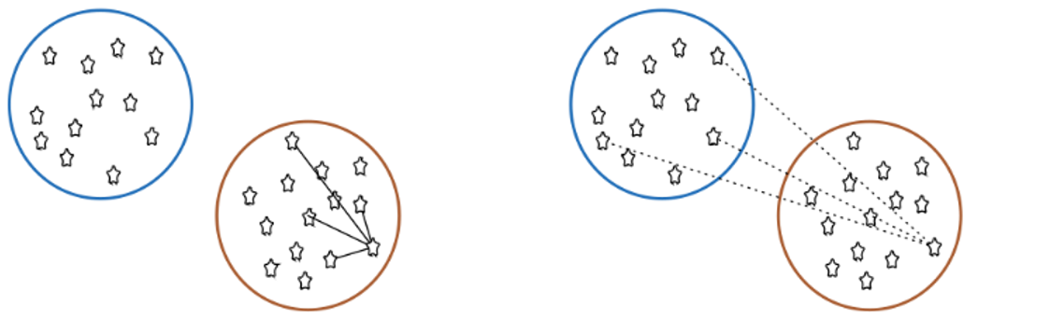
CLUSTERING OVERVIEW
In clustering, the data is divided into naturally occurring groups. Within each group, the data points are similar; from group to group, they are dissimilar.
average distance to points in own cluster (low is good)
average distance to points in neighbouring cluster (high is good)
The grouping labels are not determined ahead of time, so clustering is an example of unsupervised learning.

Slide 12
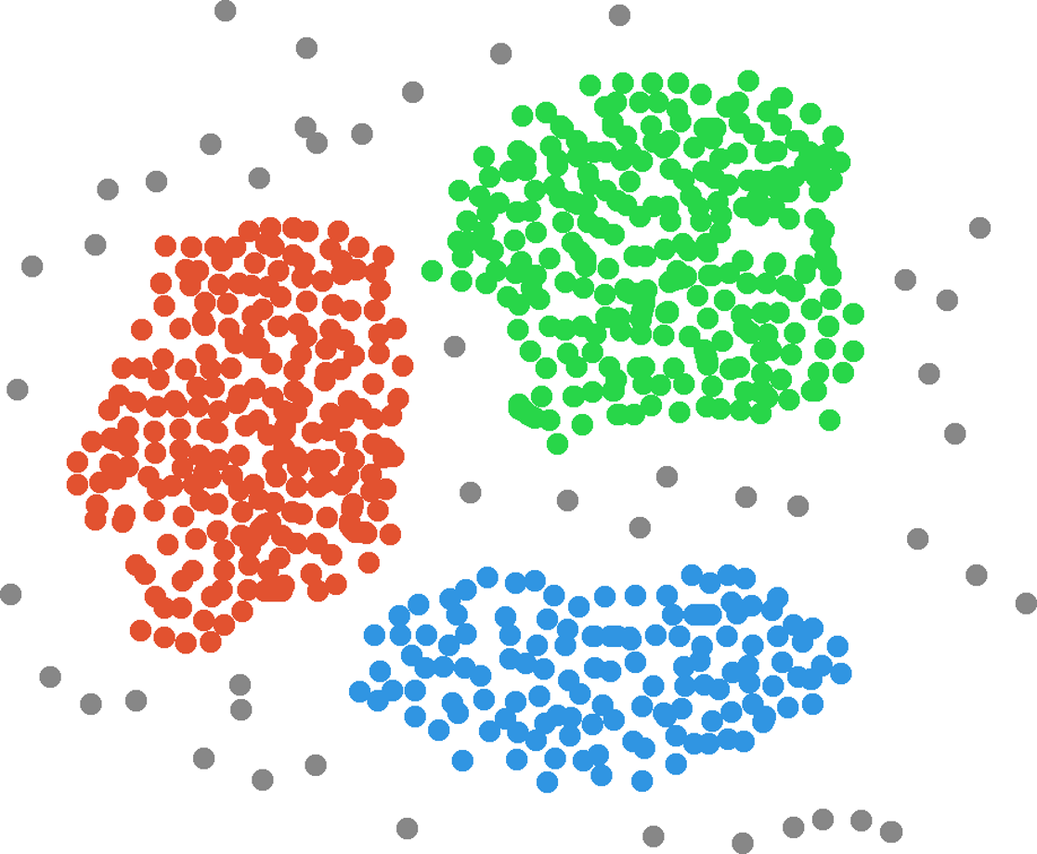
Income
Customers
Clusters
Age

Slide 13
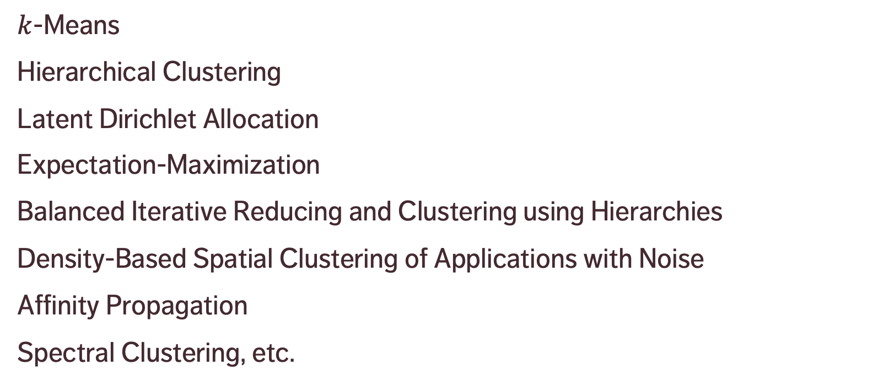
CLUSTERING METHODS
$k$-Means
Hierarchical Clustering
Latent Dirichlet Allocation
Expectation-Maximization
Balanced Iterative Reducing and Clustering using Hierarchies
Density-Based Spatial Clustering of Applications with Noise
Affinity Propagation
Spectral Clustering, etc.

Slide 14
BAD DATA
Does the dataset pass the smell test? (invalid entries, etc.)
Detecting lies and mistakes (reporting errors, use of polarizing language)
Is close enough, good enough?
Sources of bias and errors
Seeking perfection (academic, professional, government, service data)
Data science pitfalls: analysis without understanding, using only one tool (by choice/fiat), analysis for the sake of analysis, unrealistic expectations of data science, it’s on a need-to-know basis and you don’t need to know.

Slide 15
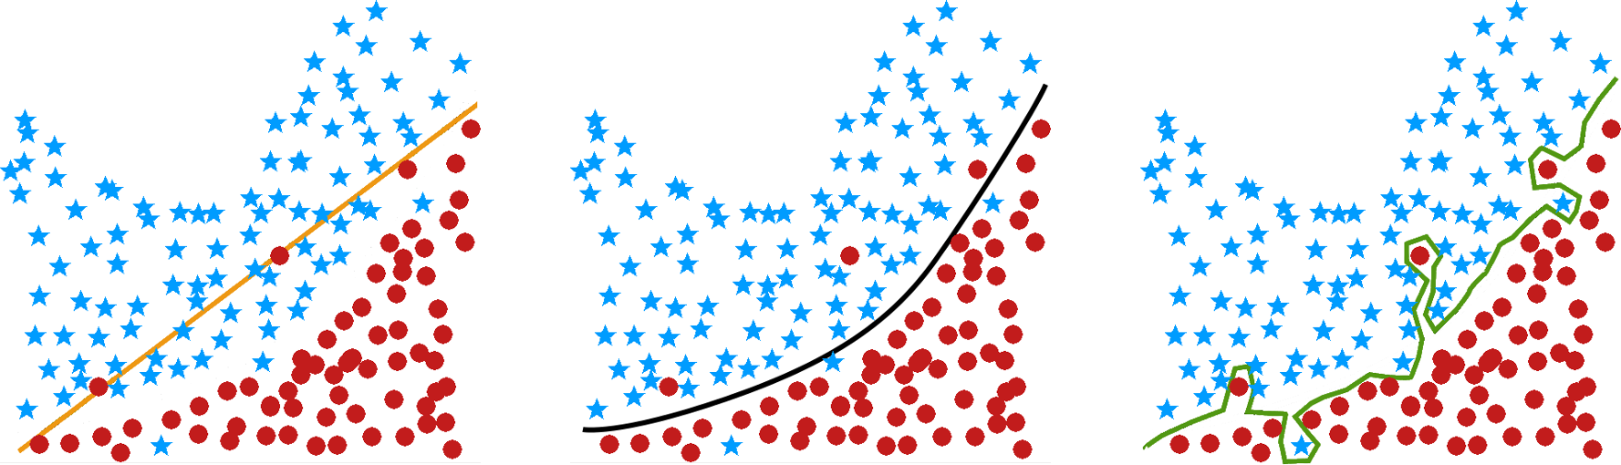
OVERFITTING
underfit
just right
overfit

Slide 16
BIG DATA VS. SMALL DATA
What is the main difference?
datasets are LARGE
issues: collection, capture, access, storage, analysis, visualization
Where does the data come from?
technology advances are lifting the limits on data processing speeds
information-sensing, mobile devices, cameras and wireless networks
What are the challenges?
most techniques were built for very small dataset
direct approach will leave the best analyst waiting years for results

Slide 17
APPROPRIATENESS & TRANSFERABILITY
Data Science methods are not appropriate if:
if one absolutely must use an existing (legacy) datasets instead of an ideal dataset (“it’s the best data we have!”)
the dataset has attributes that usefully predict a value of interest, but which are not available when a prediction is required
if one will attempt to predict class membership using an unsupervised learning algorithm
If data/model is used in other contexts, or to make predictions depending on attributes without data, validating the results is impossible.
Example: can we use a model that predicts mortgage defaulters to also predict car loan defaulters?

Slide 18
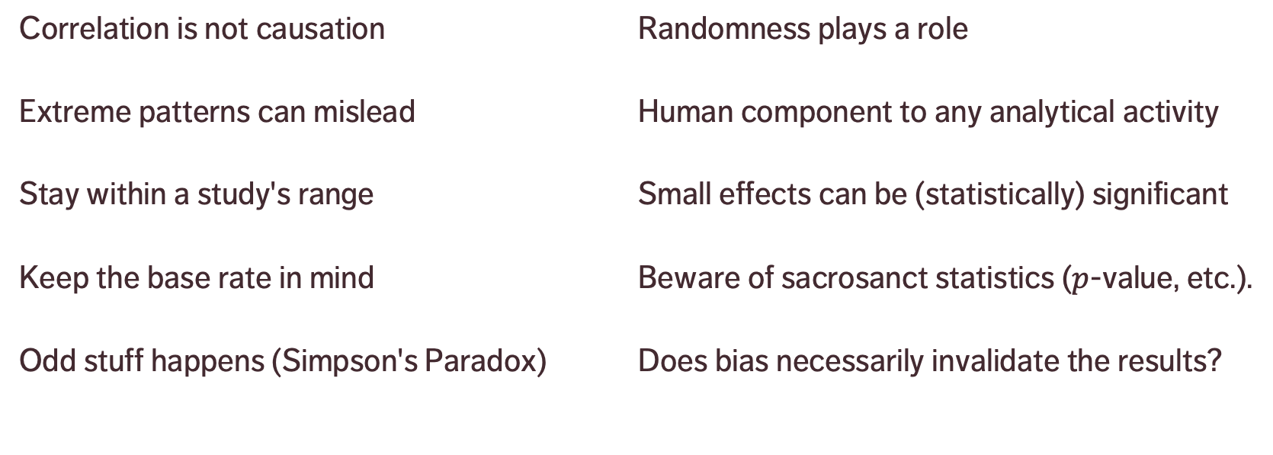
BIASES, FALLACIES & INTERPRETATION
Correlation is not causation
Extreme patterns can mislead
Stay within a study's range
Keep the base rate in mind
Odd stuff happens (Simpson's Paradox)
Randomness plays a role
Human component to any analytical activity
Small effects can be (statistically) significant
Beware of sacrosanct statistics ($p$-value, etc.).
Does bias necessarily invalidate the results?

